Slide 1
A* Pathfinder
Group members:
RA1911003010550- ANURAG SHARMA
RA1911003010554-ABHINAV ASHISH
RA1911003010558- PRANAY BHAMIDIPATI

Slide 2
Abstract
This project is about A* search algorithm, which is a computer algorithm that is widely used in path-finding and graph traversal. The process of plotting an efficiently traversal path between points, called nodes. Noted for its performance and accuracy, it enjoys widespread use. In this project, we propose a more efficient method of heuristic function to find the shortest path between two points.

Slide 3
A* has been used to solve problems of various areas such as the alignment of multiple DNA sequences in biology, path planning in robotics and digital games and classical artificial intelligence problems like the fifteen-puzzle. In spite of being extensively used, A* may present problems in some situations. Firstly, depending on the characteristics of the problem and heuristics used, its cost can be prohibitive. Also, some contexts such as dynamic environments or real-time searches may require adaptations in the original algorithm. Consequently, several extensions to the algorithm have been proposed in the last few years. This project presents a survey and classification of the main extensions to the A* algorithm that have been proposed in the literature. Since most of the extensions have specific objectives and try to improve similar points of the original algorithm, this type of classification is important to discuss and compare the new algorithms and to help users and researchers to keep track of the improvements
LITERATURE SURVEY

Slide 4
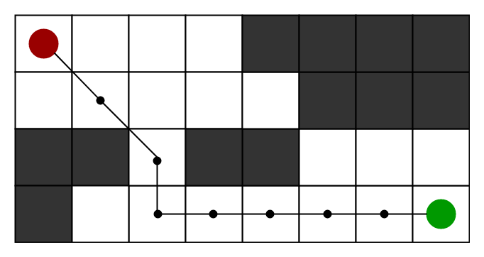
EXISTENCE
Motivation
To approximate the shortest path in real-life situations, like- in maps, games where there can be many hindrances.
We can consider a 2D Grid having several obstacles and we start from a source cell (colored red below) to reach towards a goal cell (colored green above)
(colored red below) to reach towards a goal cell (colored green below)

Slide 5
A* Search Algorithm
Step1: Place the starting node in the OPEN list.
Step 2: Check if the OPEN list is empty or not, if the list is empty then return failure and stops.
Step 3: Select the node from the OPEN list which has the smallest value of evaluation function (g+h), if node n is goal node then return success and stop, otherwise
Step 4: Expand node n and generate all of its successors, and put n into the closed list. For each successor n', check whether n' is already in the OPEN or CLOSED list, if not then compute evaluation function for n' and place into Open list.
Step 5: Else if node n' is already in OPEN and CLOSED, then it should be attached to the back pointer which reflects the lowest g(n') value.
Step 6: Return to Step 2.

Slide 6
PROPOSED ARCHITECTURE
Consider a square grid having many obstacles and we are given a starting cell and a target cell. We want to reach the target cell (if possible) from the starting cell as quickly as possible. Here A* Search Algorithm comes to the rescue.
What A* Search Algorithm does is that at each step it picks the node according to a value-‘f’ which is a parameter equal to the sum of two other parameters – ‘g’ and ‘h’. At each step it picks the node/cell having the lowest ‘f’, and process that node/cell.
We define ‘g’ and ‘h’ as simply as possible below
g = the movement cost to move from the starting point to a given square on the grid, following the path generated to get there.
h = the estimated movement cost to move from that given square on the grid to the final destination. This is often referred to as the heuristic, which is nothing but a kind of smart guess. We really don’t know the actual distance until we find the path, because all sorts of things can be in the way (walls, water, etc.). There can be many ways to calculate this ‘h’ which are discussed in the later sections.

Slide 7
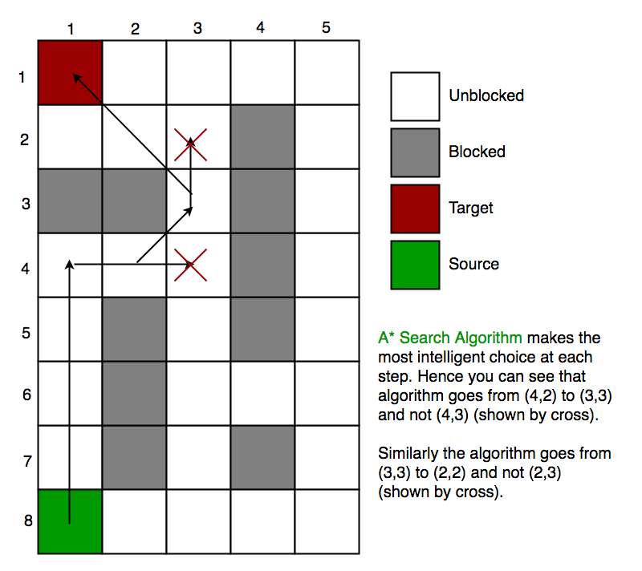
So suppose as in the below figure if we want to reach the target cell from the source cell, then the A* Search algorithm would follow path as shown below. Note that the below figure is made by considering Euclidean Distance as a heuristics.

Slide 8
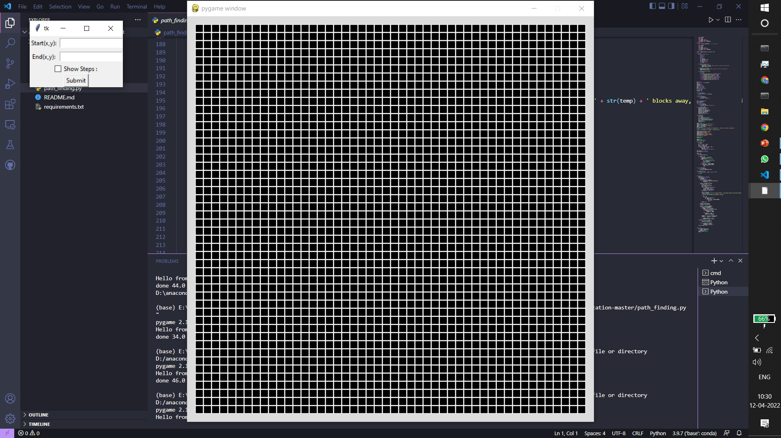
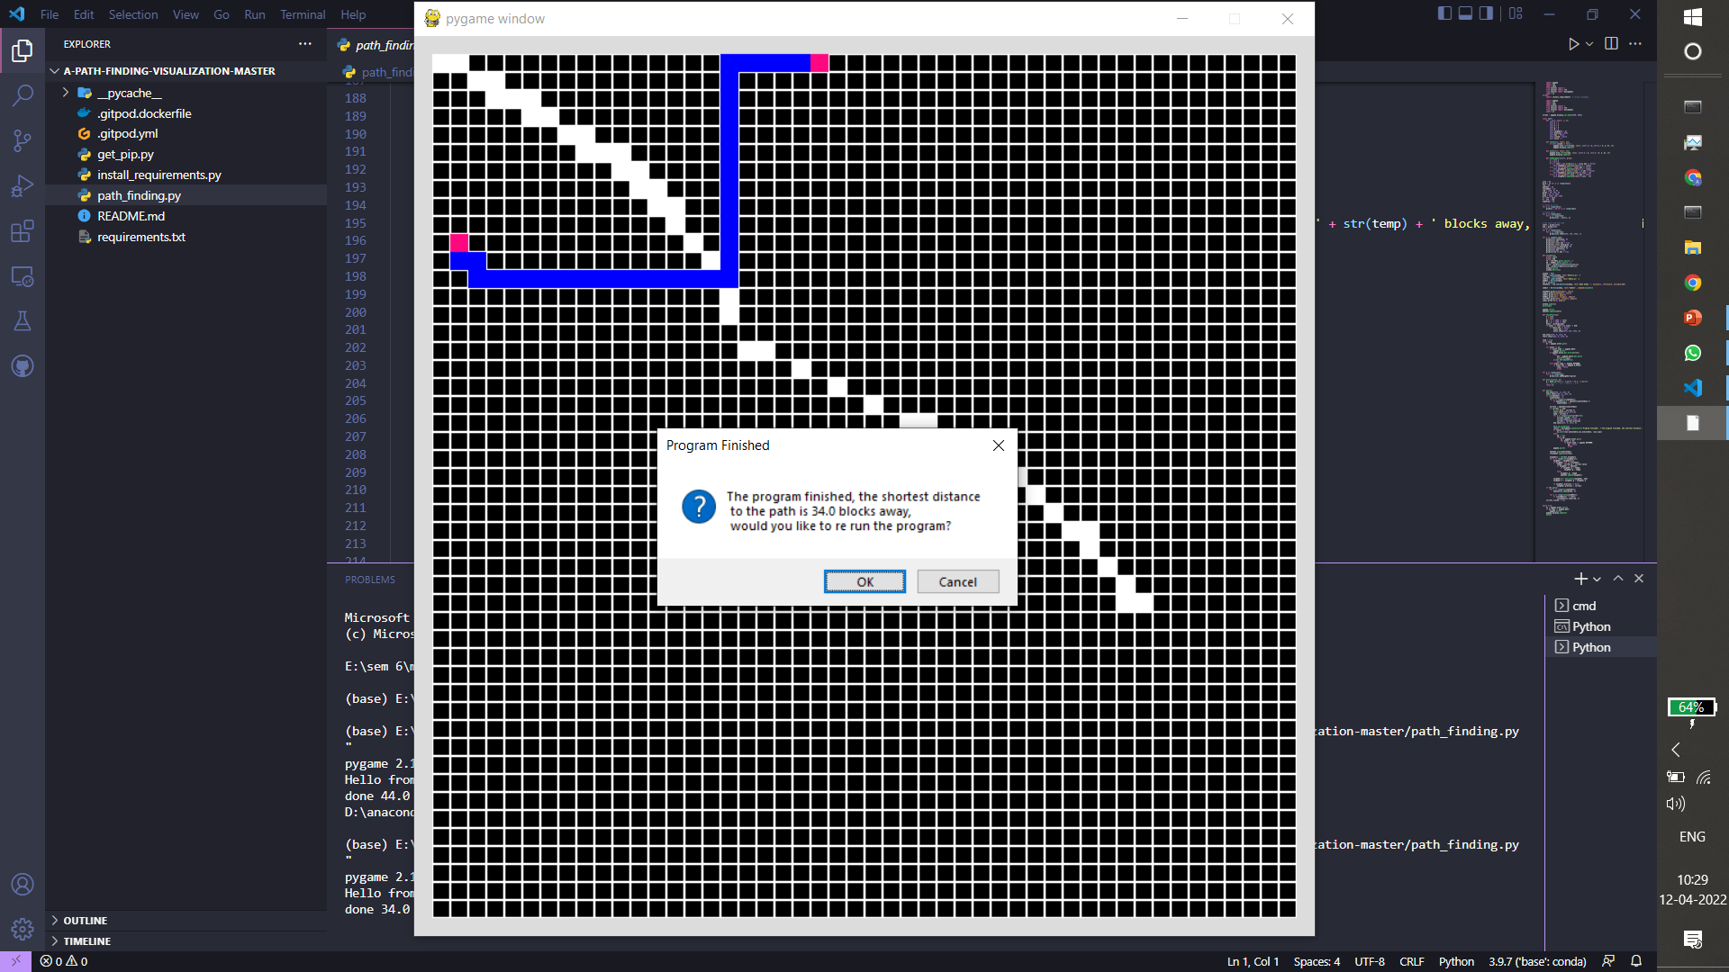
SCREENSHOTS

Slide 9
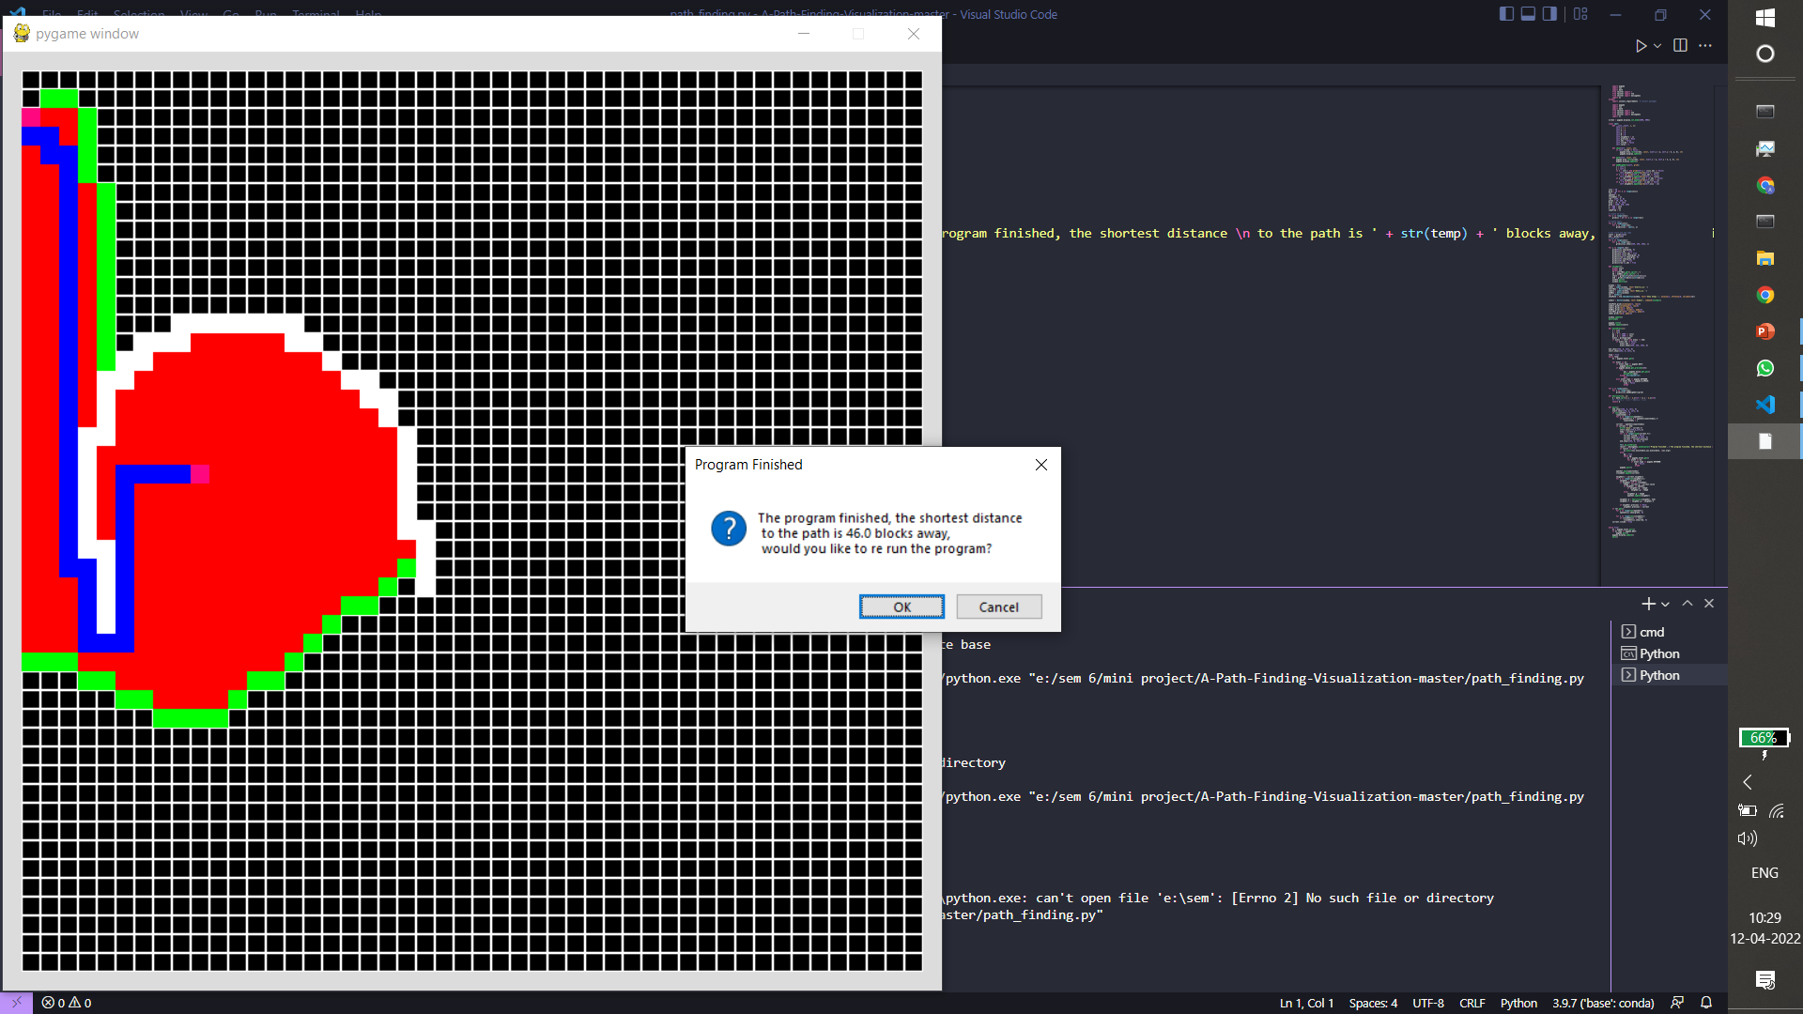

Slide 10
CONCLUSION
The A* algorithm is a powerful tool that is often used f applications such as video games, NLP problems etc. It is a searching algorithm that is used to find the shortest path between an initial and a final point. It is a handy algorithm that is often used for map traversal to find the shortest path to be taken.

Slide 11
REFERENCES
https://www.simplilearn.com/tutorials/artificial-intelligence-tutorial/a-star-algorithm
https://en.wikipedia.org/wiki/A*_search_algorithm#:~:text=%2C%20and%20SMA*.-,Applications,using%20stochastic%20grammars%20in%20NLP.

